Slide 1
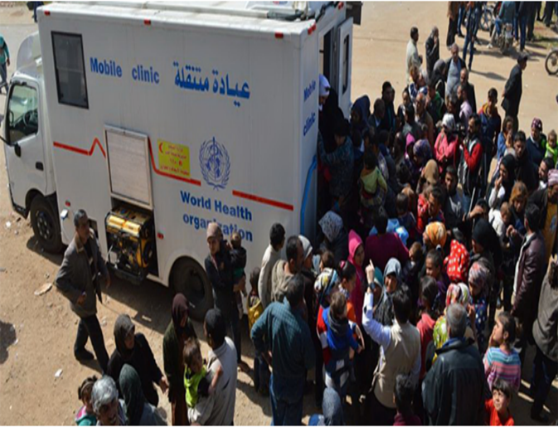
Covid-19 in Humanitarian Settings
Countries/settings with emergency-affected population and COVID-19 cases
Identified gaps in reporting
What type of population should be covered? And why?
IDPs, Refugees? Asylum seekers? Migrants?
How to improve regular reporting?
Dr Niluka Wijekoon
Epidemiologist
HQ WHE/ HIM/FES

Slide 2
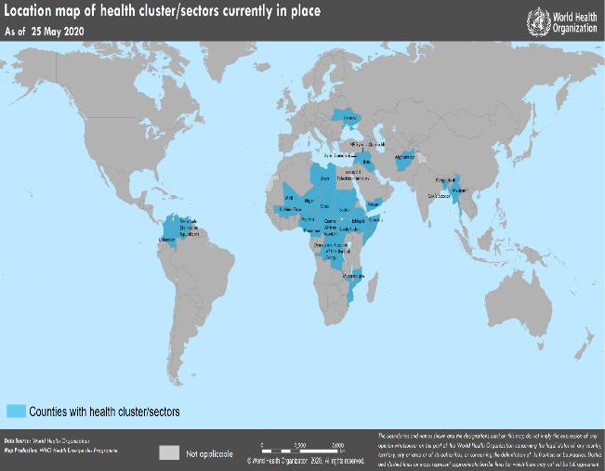
COVID-19 in Humanitarian settings
Approximately 65M emergency-affected population, represented in 27 country health clusters across 4 regions
Most emergency-affected populations living in AFRO and EMRO regions

Slide 3
COVID-19 in Humanitarian settings
Significant number of countries with health cluster are having COVID-19 community transmission.
Reliability of the assigned transmission level of the remaining countries?? E.g. Yemen, Afghanistan

Slide 4
COVID-19 in Humanitarian settings – data as of 27 .05.2020
Covid-19 Cases and Deaths in countries with active clusters
There is no regular reporting of cases and deaths from humanitarian sites in the regional dashboards.

Slide 5
COVID-19 Situation in humanitarian settings – GHC Survey findings
Global Health Cluster Survey conducted 3-8 April 2020, n= 27 country health clusters;
Establishment of EWAR/Surveillance to detect COVID-19 cases:
Training on contact tracing:
Expansion of isolation capacities for COVID-19 suspected / confirmed cases:

Slide 6
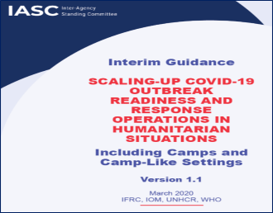
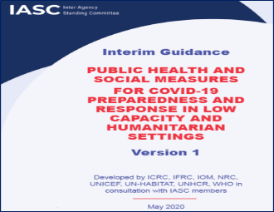
COVID-19 Situation in humanitarian settings
Technical guidance addressing EWAR, case detection, case investigation, testing & contact tracing
Interim Guidance on Scaling-up COVID-19 Outbreak in Readiness and Response Operations in Camps and Camp-like Settings (jointly developed by IFRC, IOM, UNHCR and WHO)
Interim Guidance on Public Health and Social Measures for COVID-19 Preparedness and Response Operations in Low Capacity and Humanitarian Settings

Slide 7
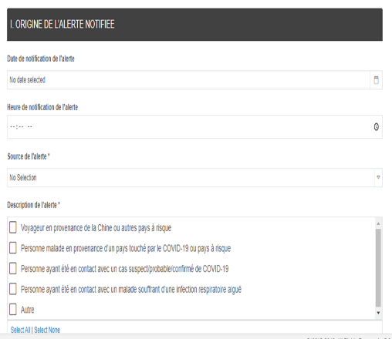
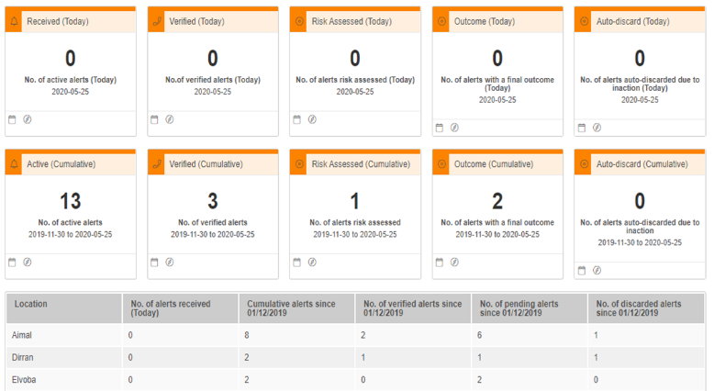
COVID-19 Situation in humanitarian settings
Support to humanitarian settings with EWARS-in-a-Box
Enhancement features around COVID-19 alerts from the field, automated COVID-19 daily dashboard
Surveillance webinars targeting HCCs and health partners - COVID-19 EWAR and surveillance Webinar for Health Cluster Coordinators on 30/April, READY initiative - planned

Slide 8
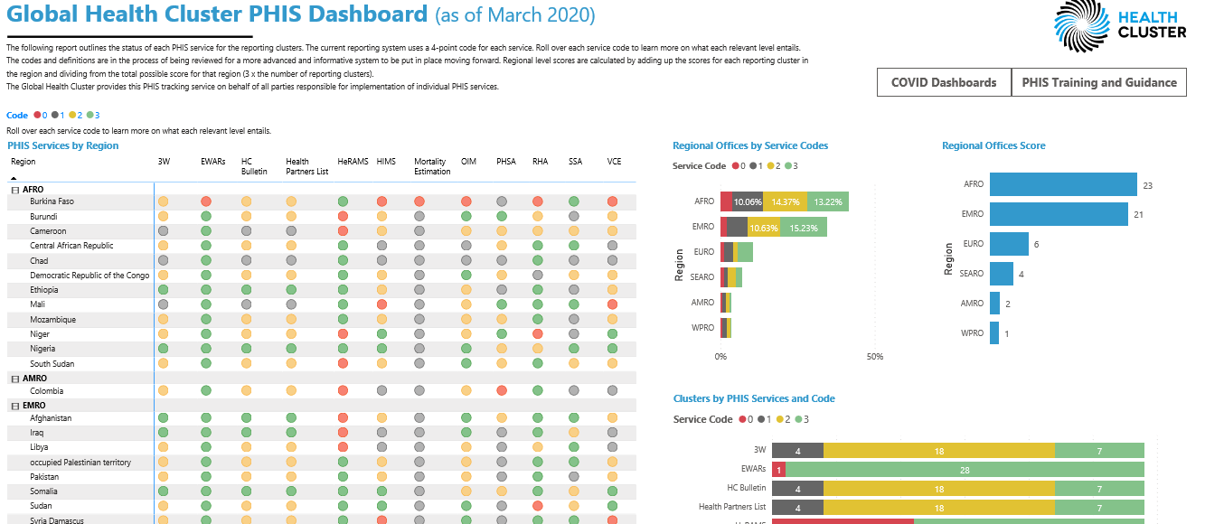
What regular reporting mechanisms are in place…
Country cluster regular reporting to Global Health Cluster Dashboard

Slide 9
Case detection and reporting in humanitarian settings
Rumors from the community
Alerts from Community Health Volunteers
Alerts from Community Health Workers
Alerts from PHCCs
Verification
Suspected case of COVID-19?
YES
Confirmatory Testing
Confirmed case? YES
Report to WHO at national level
Report to WHO at Regional Level
Report to WHO HQ

Slide 10
COVID-19 Situation in humanitarian settings
Despite established mechanisms..
Difficulty in detection of cases due to remoteness, security, lack of robust early warning systems, etc
Unavailability of PCR testing – testing capacity is low in most settings
Difficulties in maintaining containment measures
Overcrowding
Lack of water and sanitation for hand hygiene
Lack of isolation facilities, difficulty in isolating mild cases at home
Lack if quarantine facilities
Lack of cooperation in contact tracing
Lack of data on disease severity, outcomes in populations with SAM, HIV/AID, TB
Will lack of testing lead to missing cases on regular basis? thus lack of containment measures etc until it is too late..

Slide 11
Reporting of COVID-19 among refugees, migrants ..
COVID-19 cases in Bahrain
2 COVID-19 cases at Dadaab Refugee camp, Kenya
Over 217,000 refugees and 320,000 host communities

Slide 12
COVID-19 Situation in humanitarian settings
To avoid missing significant alerts/rumors from clusters, health partners, or community, WHO proposes COVID-19 alert reported directly to HQ
27 Health clusters
Individual health partners (IMTT)
WHO Regional offices
Events detected during media monitoring
This does not replace existing EWAR/HIS in place.
But provides a channel to raise alerts to gain due attention
outbreak@who.int with HUMANITARIAN COVID ALERT in the subject line
Verification & Action

